Slide 1
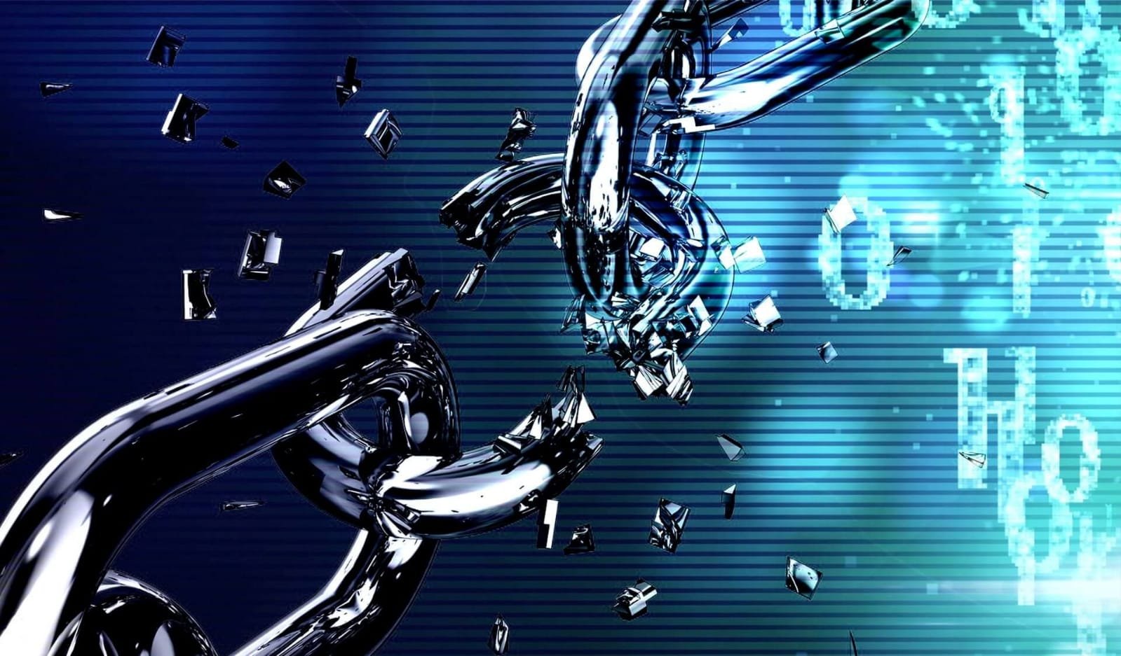
CYBER KILL CHAIN
Presented by: SHLOMO KURUVILLA Mathew
Date : 05-11-2024

Slide 2
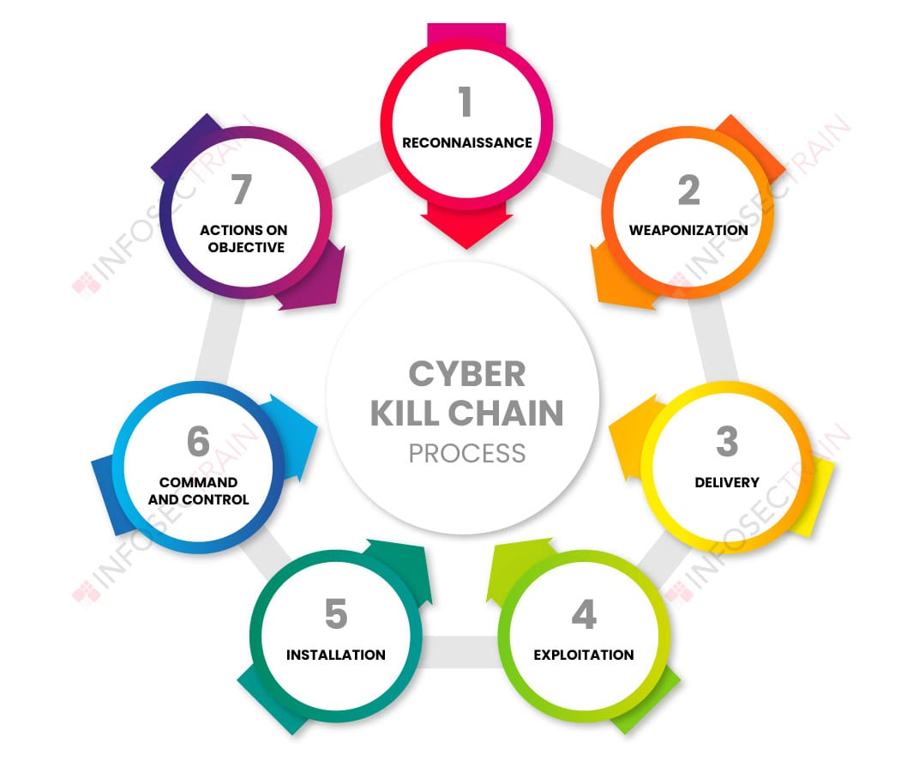
CYBER KILL CHAIN
Cyber Kill Chain is a model or a framework.
It describes series of steps that trace stages of a cyberattack from the early reconnaissance stages to the exfiltration of data.
It divided into 7 stages.

Slide 3
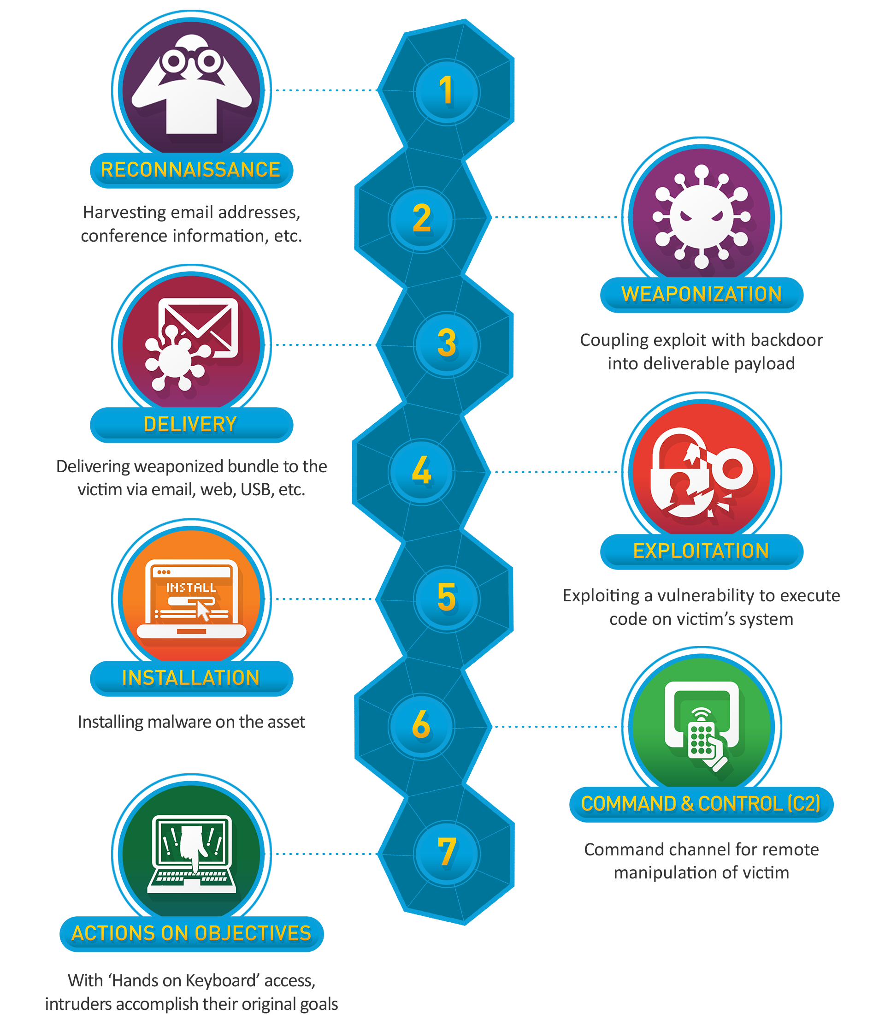
Overview
Stages of Cyber Kill Chain:
1. Reconnaissance
2. Weaponization
3. Delivery
4. Exploitation
5. Installation
6. Command & Control (C2)
7. Actions on Objectives

Slide 4
Reconnaissance
Attackers gather information about the target.
Methods:
Collecting public data (OSINT).
Deploying spying tools.
Using automated scanners to detect security systems or third-party applications..
Goal: Identify vulnerabilities

Slide 5
Weaponisation
• Crafting the attack vector.
• Components: Creating malware or malicious payloads, selecting delivery methods.
Process :
designing new malware forms
modifying existing programs to match specific vulnerabilities
• Outcome: A malicious payload ready for delivery.

Slide 6
Delivery
Transmitting the weapon to the target.
Methods: Phishing emails, malicious links, USB drives, social engineering tactics, or through vulnerabilities in target's software or hardware.
Goal : trick target into executing payload, giving attacker access to target's systems.

Slide 7
Exploitation
Activating payload on target's system.
Techniques: Exploiting software vulnerabilities.
Result: Gaining access to the system.
Exploitation achieved through techniques such as buffer overflows, code injection, and other methods.

Slide 8
Installation
Payload or weapon installs after the exploit to gain a persistence access.
Objectives
Gain unauthorized access to target systems.
Establish persistence within the target environment.
Ensure the deployment of malware or malicious tools.

Slide 9
Command and control
Establishing communication with compromised systems.
Methods: Backdoors, remote access tools.
Actions on objectives
Actions on Objectives: Achieving attacker's goals (data theft,destruction, encryption or exfiltration).

Slide 10
TATICS AND TECHNIQUES
Social engineering:
Manipulating human behavior to facilitate access.
Remote access Trojans (RATs):
Establishing persistent access to compromised systems.
Command and control (C2):
Establishing communication channels for further exploitation.

Slide 11
NOTABLE CYBER ATTACK
WannaCry Ransomware Attack.
NotPetya Cyberattack.
Sony Pictures Hack.
Target Data Breach.
Equifax Data Breach.

Slide 12
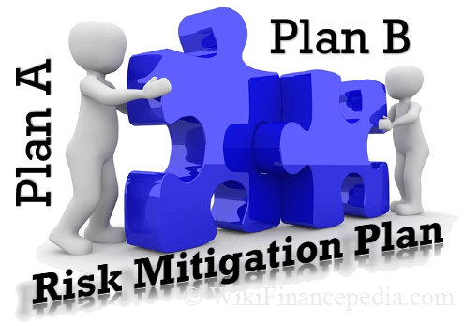
MITIGATIONS
Employee training and awareness
Endpoint protection
Incident response plan
Multi factor authentication
Implementing security awareness training.
Utilizing advanced threat detection.
Firewall and network security
Regularly updating and patching systems.
Backup and disaster recovery.
Access control

Slide 13
CONCLUTION
Cybersecurity is a continuous effort; remain vigilant and proactive in defending against cyber threats. Thank you for your attention. Together, we can strengthen our defenses and protect against cyber attacks

Slide 14
THANK YOU

